Slide 1
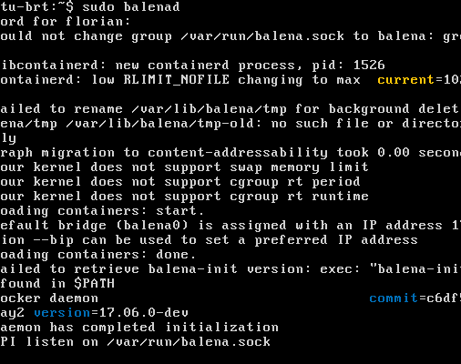
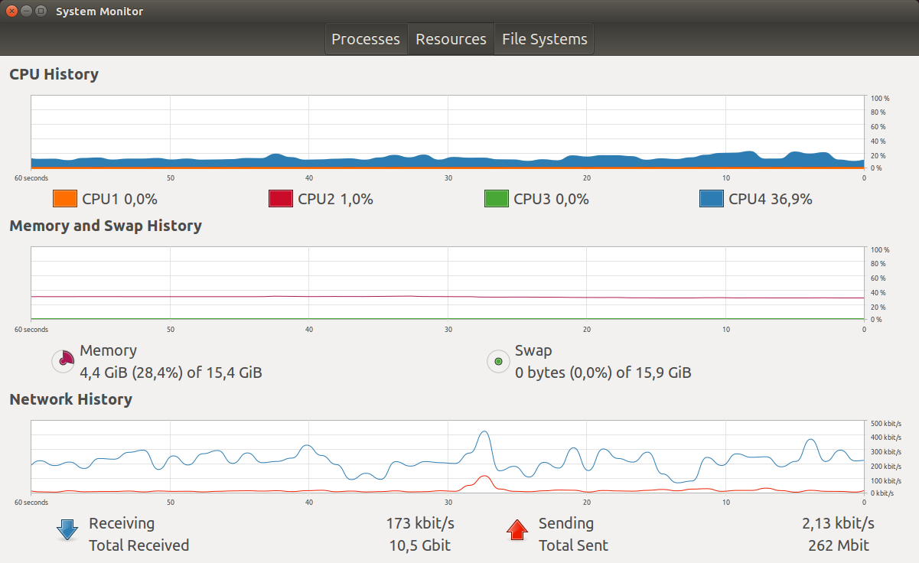
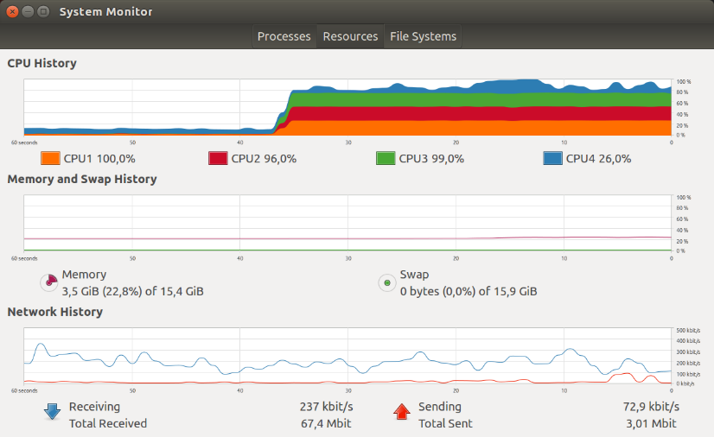
Progress of VM tests
Investigated messages and warnings plot by balena, fixed where possible
Setup CPU isolation for VM on host (see pictures), CPU 0-2 for guest VM, 3 for all host tasks
Addition Irq affinity or deactivation of load balancing on host increases hugely jitter of RT execution >>1sec
CPU isolation and settings on guest to separate RT and non RT have no big impact
Results suggest that a hosted guest in AWS (no bare metal) might have some jitter peaks due to vCPU rescheduling of Xen, even though it has a RTDS scheduler for RT applications
Currently testing deployment and run of a Balena container with a dummy app (counter)

